Slide 1
Set 2 Blind Test of Breast Cancer Plasma Samples

Slide 2
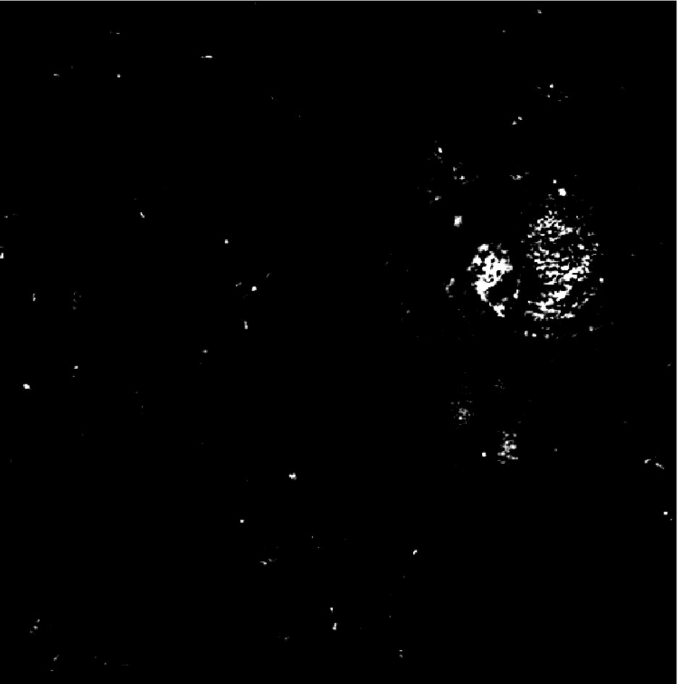

PANORAMA of Plasma Sample 101 (Prediction: Healthy)
Time: 60 min
Count: 265 (Ex: 182; Large: 83)
Time: 60 min wash
Count: 35
Based On Count: Before wash count higher than CI Healthy (64-172)
After wash count higher than 99% CI Healthy (5-28) ) but lower than 70
Note: 0 % response to miRNA-21
Look healthy

Slide 3
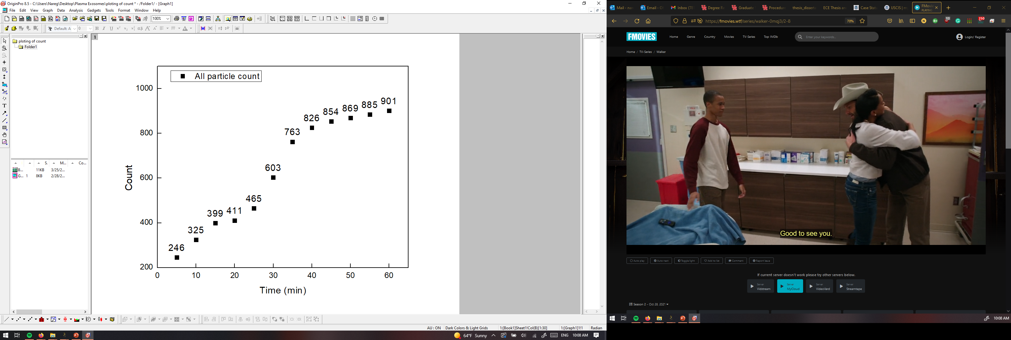
PANORAMA of Plasma Sample 102 (Prediction: Cancer)
Time: 60 min
Count: 901 (Ex: 535; Large: 297)
Time: 60 min wash
Count: 190
Based On Count: : Before wash count match CI stage I lung cancer 1 (950-1558)
After wash count match CI of stage I lung cancer (151-370)
Note: 6 % response to miRNA-21
Scale bar: 10 µm

Slide 4
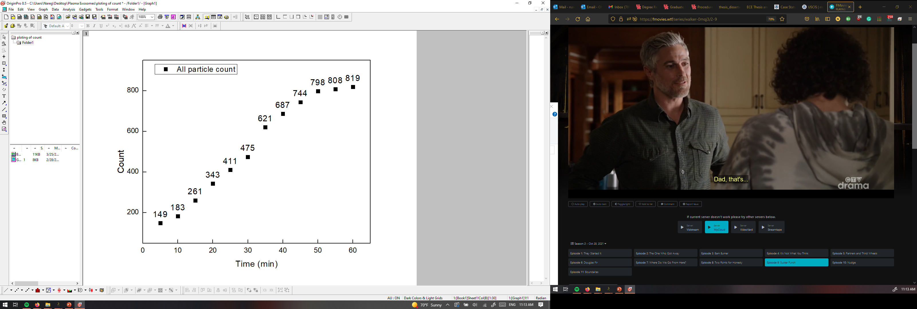
PANORAMA of Plasma Sample 103 (Prediction: Healthy)
Time: 60 min
Count: 819 (Ex: 718; Large101)
Time: 60 min wash
Count: 25
Based On Count: : Before wash count match CI stage I lung cancer 1 (950-1558)
After wash count match CI of Healthy (7-28)
Note: 0 % response to miRNA-21
Scale bar: 10 µm

Slide 5
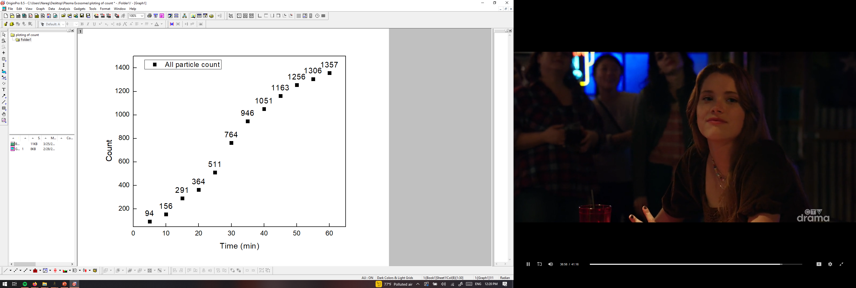
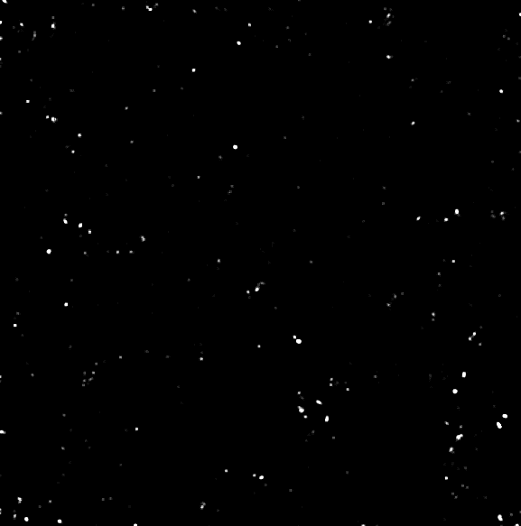
PANORAMA of Plasma Sample 104 (Prediction: Cancer)
Time: 60 min
Count: 901 (Ex: 535; Large: 297)
Time: 60 min wash
Count: 190
Based On Count: : Before wash count match CI stage I lung cancer 1 (950-1558)
After wash count match CI of stage I lung cancer (151-370)
Note: 0 % response to miRNA-21
Scale bar: 10 µm

Slide 6
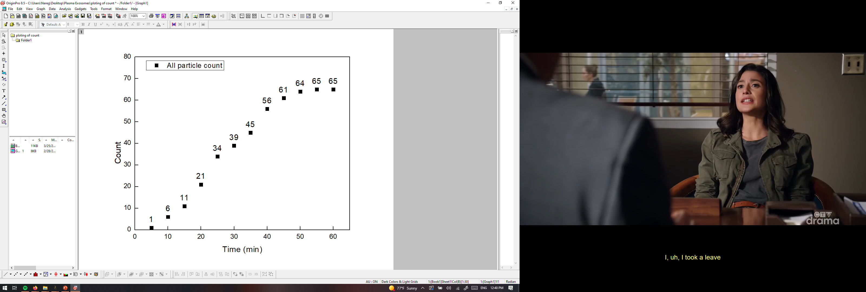
PANORAMA of Plasma Sample 105 (Prediction: Healthy)
Time: 60 min
Count: 63 (Ex: 54; Large: 9)
Time: 60 min wash
Count: 11
Based On Count: : Before wash count match CI Healthy (64-172)
After wash count match CI of Healthy (7-28)
Note: 0 % response to miRNA-21
Scale bar: 10 µm

Slide 7
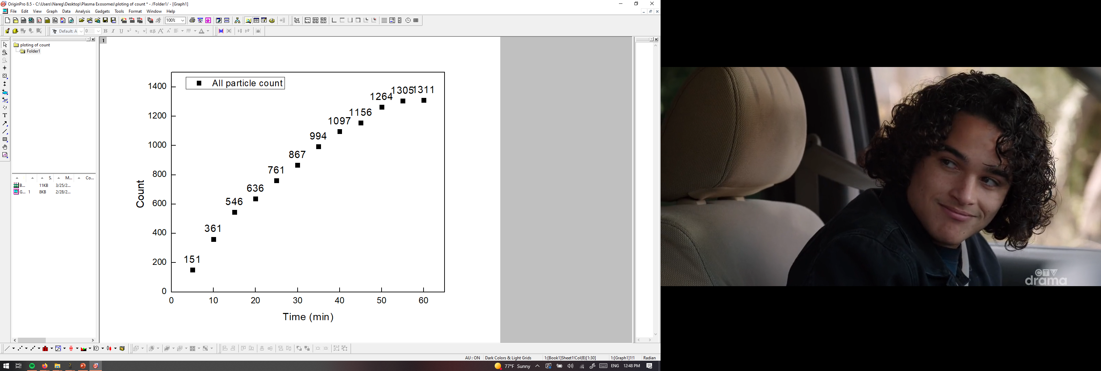
PANORAMA of Plasma Sample 106 (Prediction: Cancer)
Time: 60 min
Count: 1311 (Ex: 734; Large: 577)
Time: 60 min wash
Count: 153
Based On Count: : Before wash count match CI stage I lung cancer 1 (950-1558)
After wash count match CI of stage I lung cancer (151-370)
Note: 12 % response to miRNA-21
Scale bar: 10 µm

Slide 8
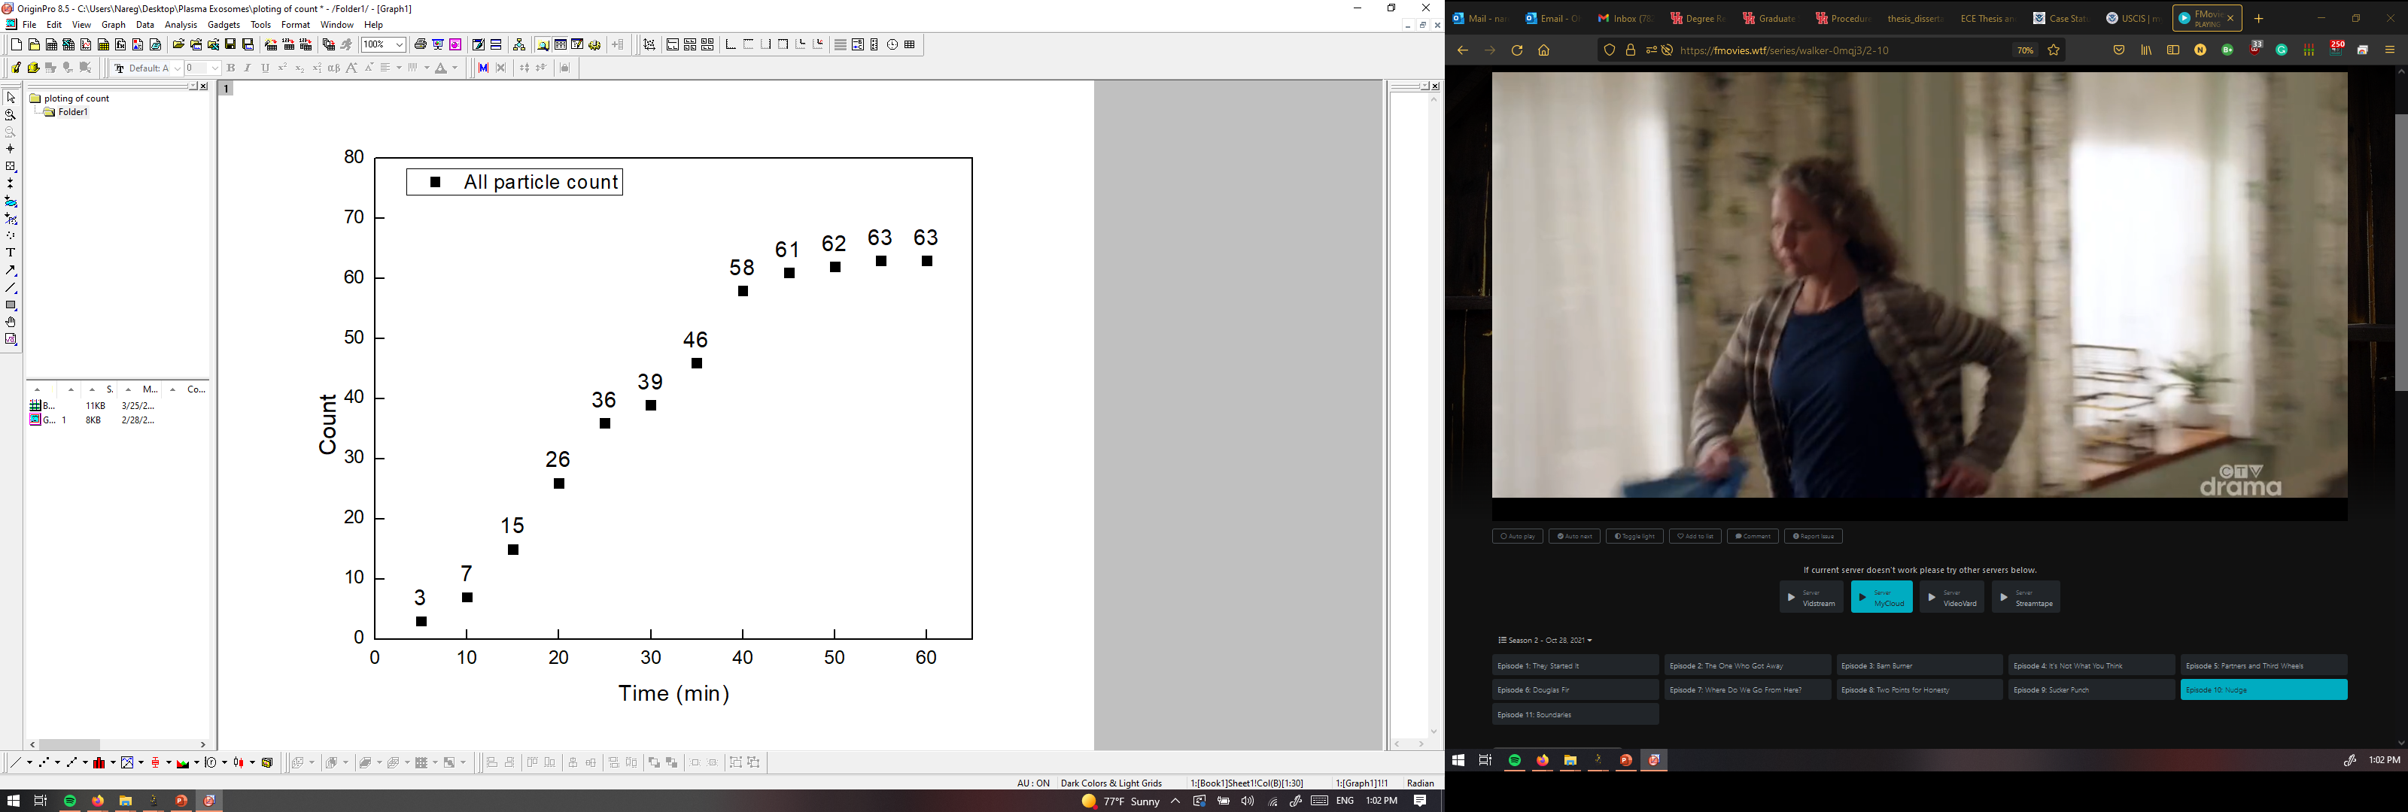
PANORAMA of Plasma Sample 107 (Prediction: Healthy)
Time: 60 min
Count: 63 (Ex: 54; Large: 9)
Time: 60 min wash
Count: 11
Based On Count: : Before wash count match CI Healthy (64-172)
After wash count match CI of Healthy (7-28)
Note: 0 % response to miRNA-21
Scale bar: 10 µm

Slide 9
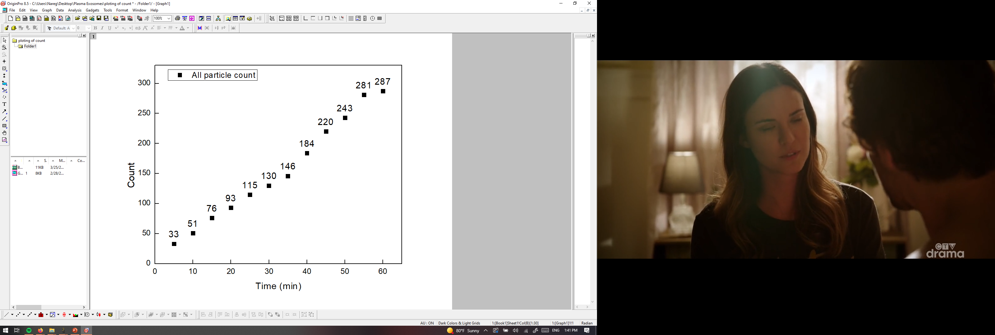

PANORAMA of Plasma Sample 108 (Prediction: Healthy)
Time: 60 min
Count: 287 (Ex: 256; Large: 31)
Time: 60 min wash
Count: 43
Based On Count: : Before wash count match CI Healthy (64-172)
After wash count match CI of Healthy (7-28)
Note: 0 % response to miRNA-21
Scale bar: 10 µm

Slide 10
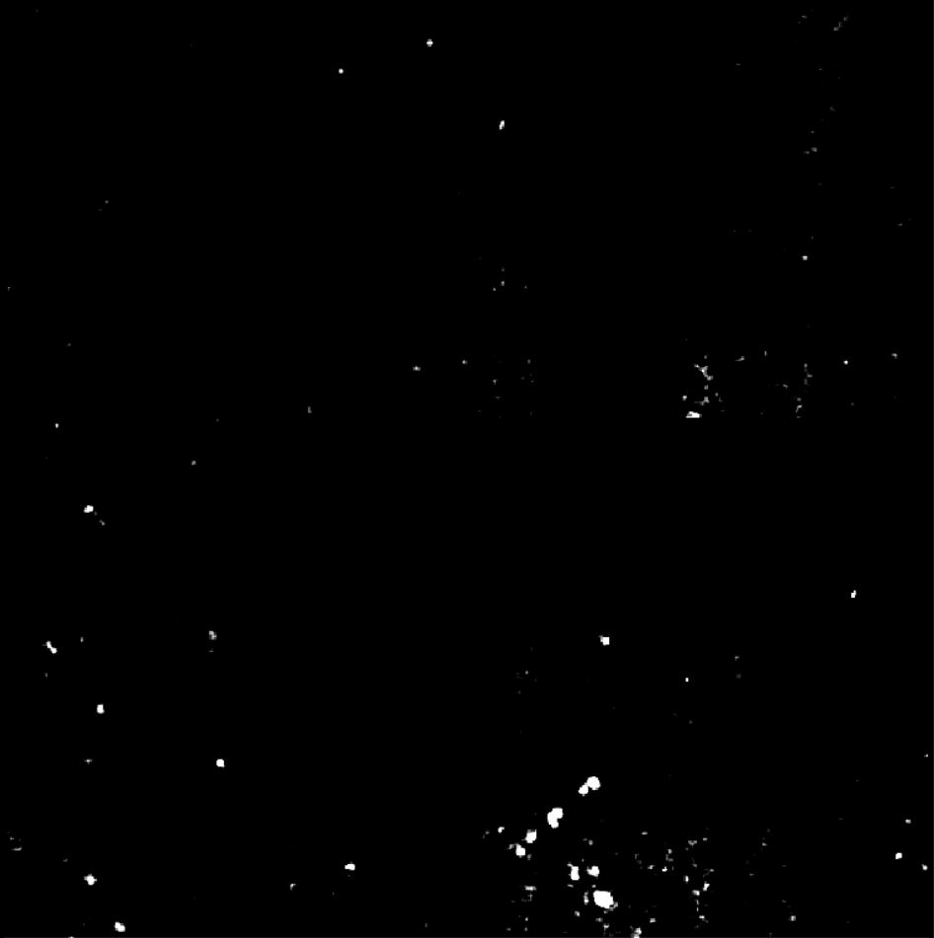
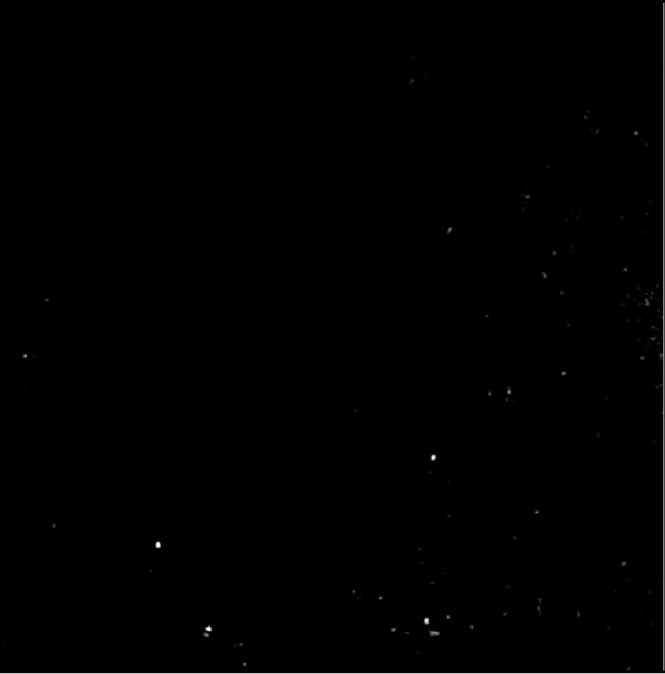
Image of Detected Particles via PANORAMA (109)
Time: 60 min
Count: 208 (Ex: 180; Large: 28)
Time: 60 min wash
Count: 109
Based On Count: Before wash count lower than CI of stage 1 (950-1558)
After wash lower than CI stage 1 (151-370) and
higher than Healthy (5-70)
Note: 0 % response to miRNA-21
Look cancerous
Scale Bar: 10 µm

Slide 11


PANORAMA of Plasma Sample 110 (Prediction: Cancer)
Time: 60 min
Count: 320 (Ex: 258; Large: 62)
Time: 60 min wash
Count: 137
Based On Count: Before wash count lower than CI of stage 1 (950-1558)
After wash lower than CI stage 1 (151-370) and
higher than Healthy (5-70)
Note: 0% response to miRNA-21
Look cancerous
Scale Bar: 10 µm

Slide 12
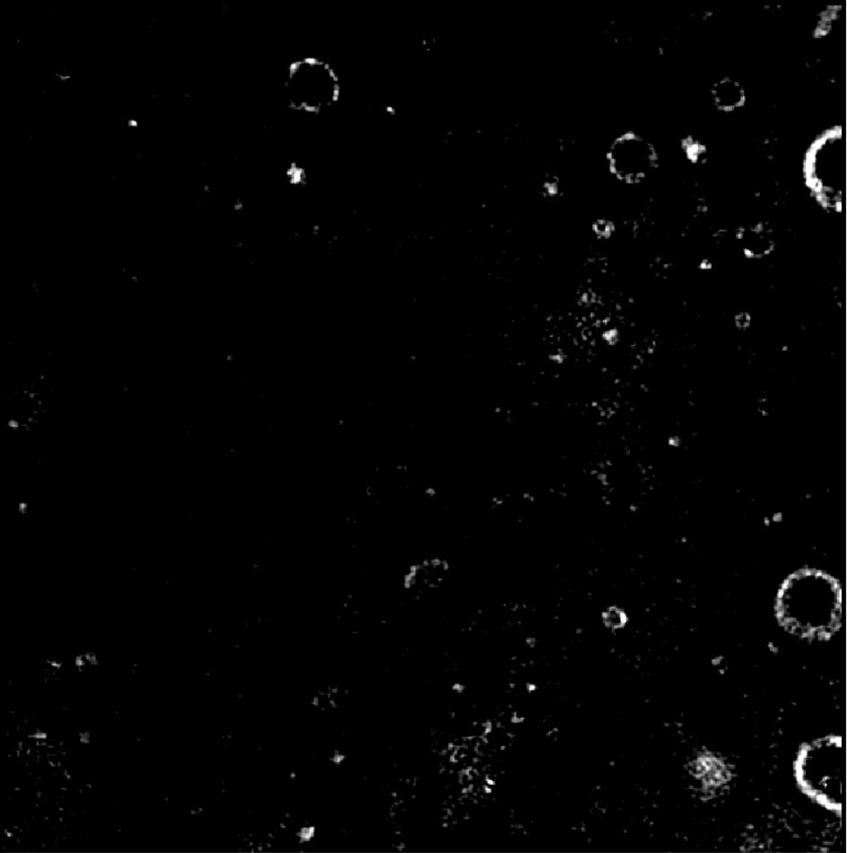

PANORAMA of Plasma Sample 111 (Prediction: Healthy)
Time: 60 min
Count: 158 (Ex: 123; Large: 35)
Time: 60 min wash
Count: 39
Based On Count: Before wash count matches CI Healthy (64-172)
After wash count higher than 99% CI Healthy (5-28) ) but lower than 70
Note: 0 % response to miRNA-21
Look healthy
Scale Bar: 10 µm

Slide 13
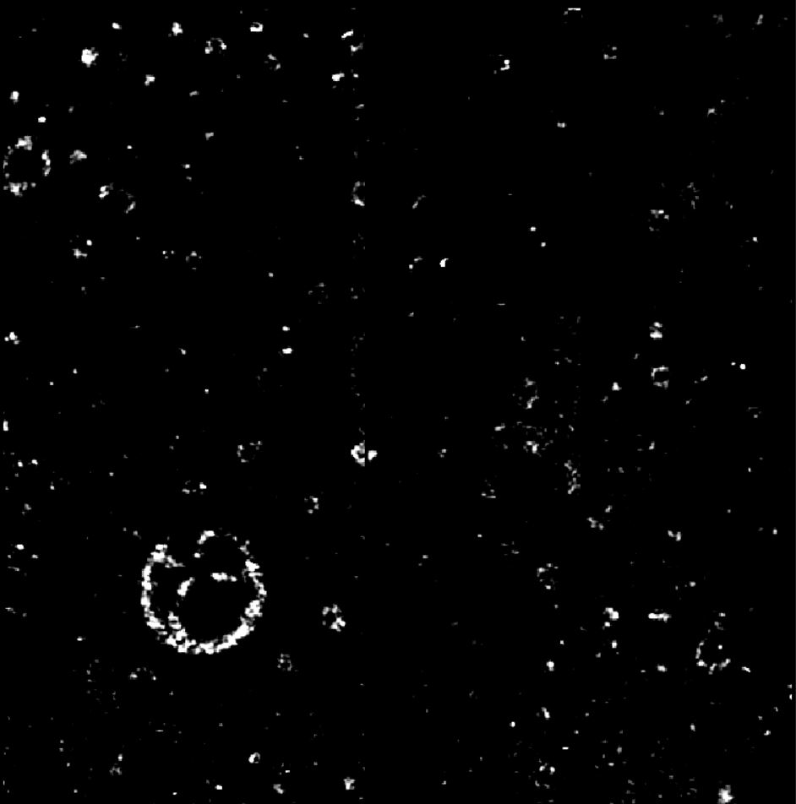

PANORAMA of Plasma Sample 112 (Prediction: Healthy)
Time: 60 min
Count: 244 (Ex: 207; Large: 37)
Time: 60 min wash
Count: 30
Based On Count: Before wash count higher than CI Healthy (64-172)
After wash count higher than 99% CI Healthy (5-28) but lower than 70
Note: 0 % response to miRNA-21
Look healthy
Scale Bar: 10 µm

Slide 14
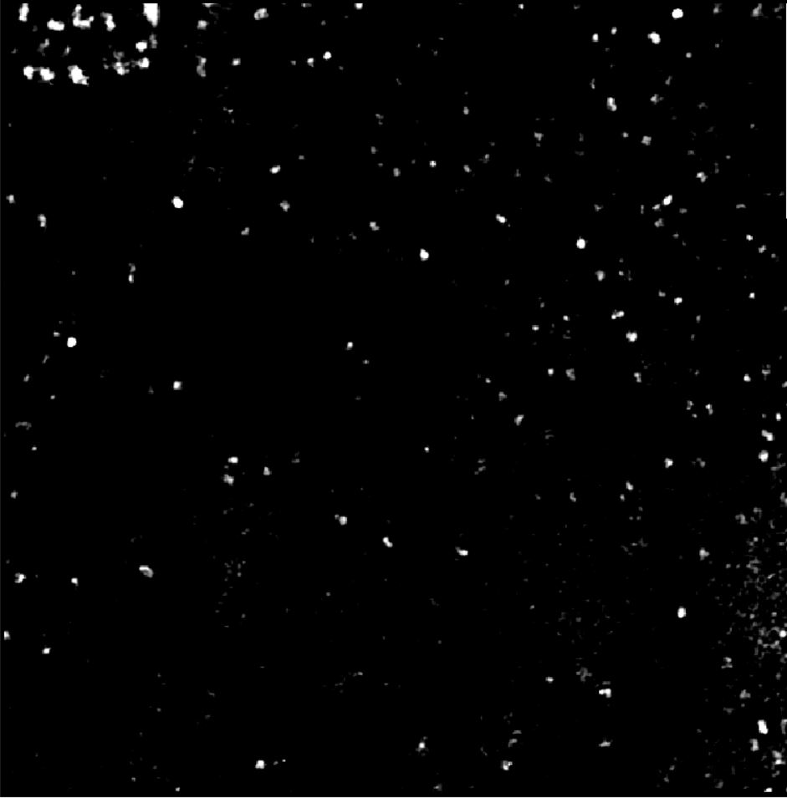
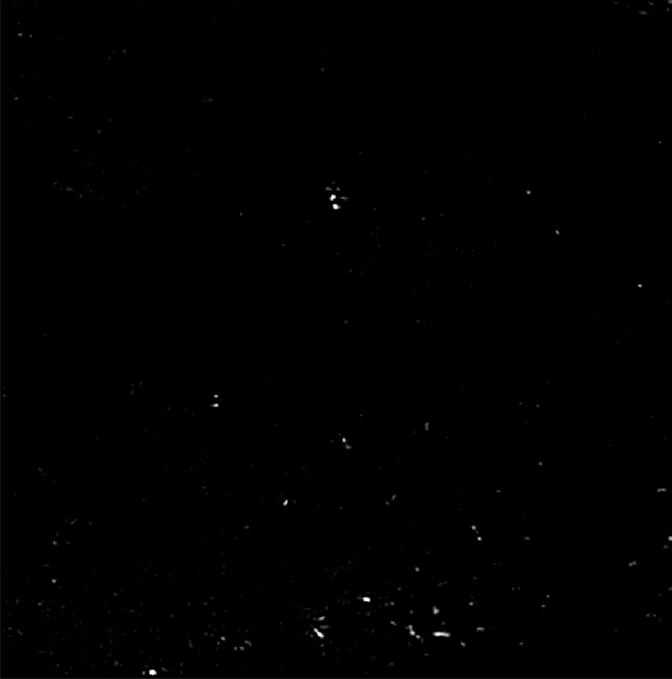
PANORAMA of Plasma Sample 113 (Prediction: Cancer)
Time: 60 min
Count: 236 (Ex: 176; Large: 60)
Time: 60 min wash
Count: 123
Based On Count: Before wash count lower than CI of stage 1 (950-1558)
After wash lower than CI stage 1 (151-370) and
higher than Healthy (5-70)
Note: 0 % response to miRNA-21
Look cancerous
Scale Bar: 10 µm

Slide 15
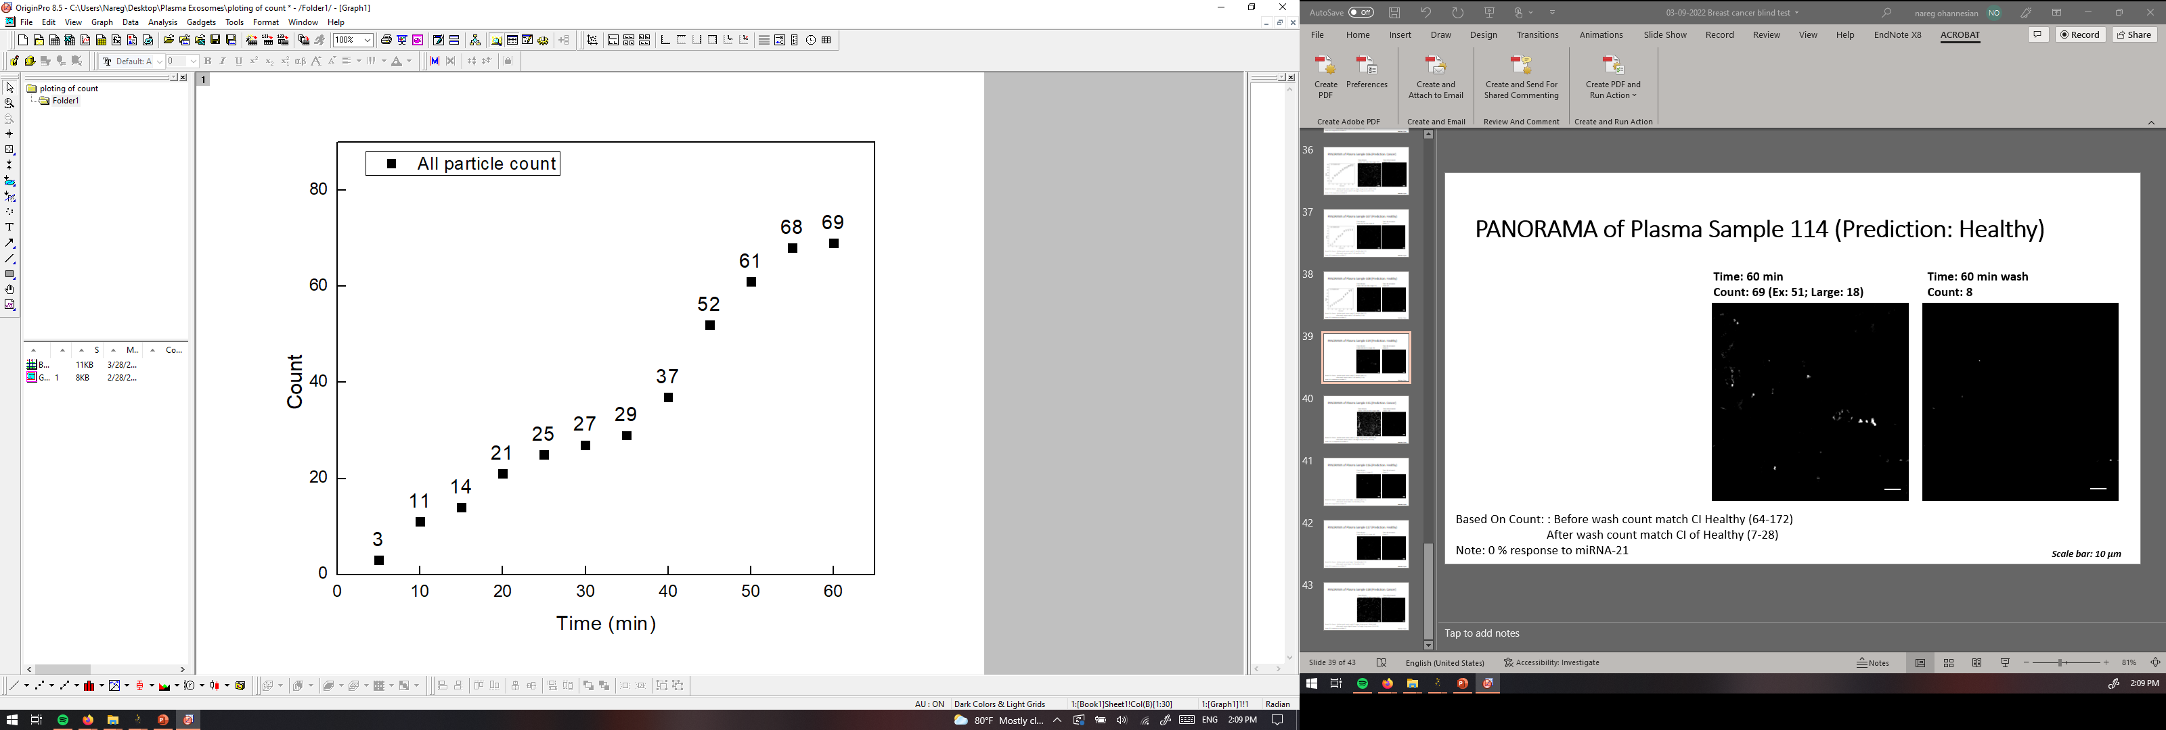
PANORAMA of Plasma Sample 114 (Prediction: Healthy)
Time: 60 min
Count: 69 (Ex: 51; Large: 18)
Time: 60 min wash
Count: 8
Based On Count: : Before wash count match CI Healthy (64-172)
After wash count match CI of Healthy (7-28)
Note: 0 % response to miRNA-21
Scale bar: 10 µm

Slide 16
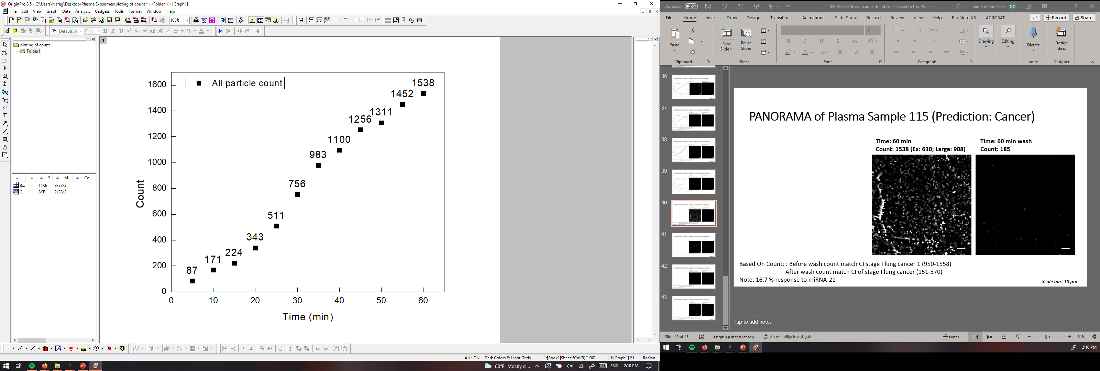
PANORAMA of Plasma Sample 115 (Prediction: Cancer)
Time: 60 min
Count: 1538 (Ex: 630; Large: 908)
Time: 60 min wash
Count: 185
Based On Count: : Before wash count match CI stage I lung cancer 1 (950-1558)
After wash count match CI of stage I lung cancer (151-370)
Note: 16.7 % response to miRNA-21
Scale bar: 10 µm

Slide 17
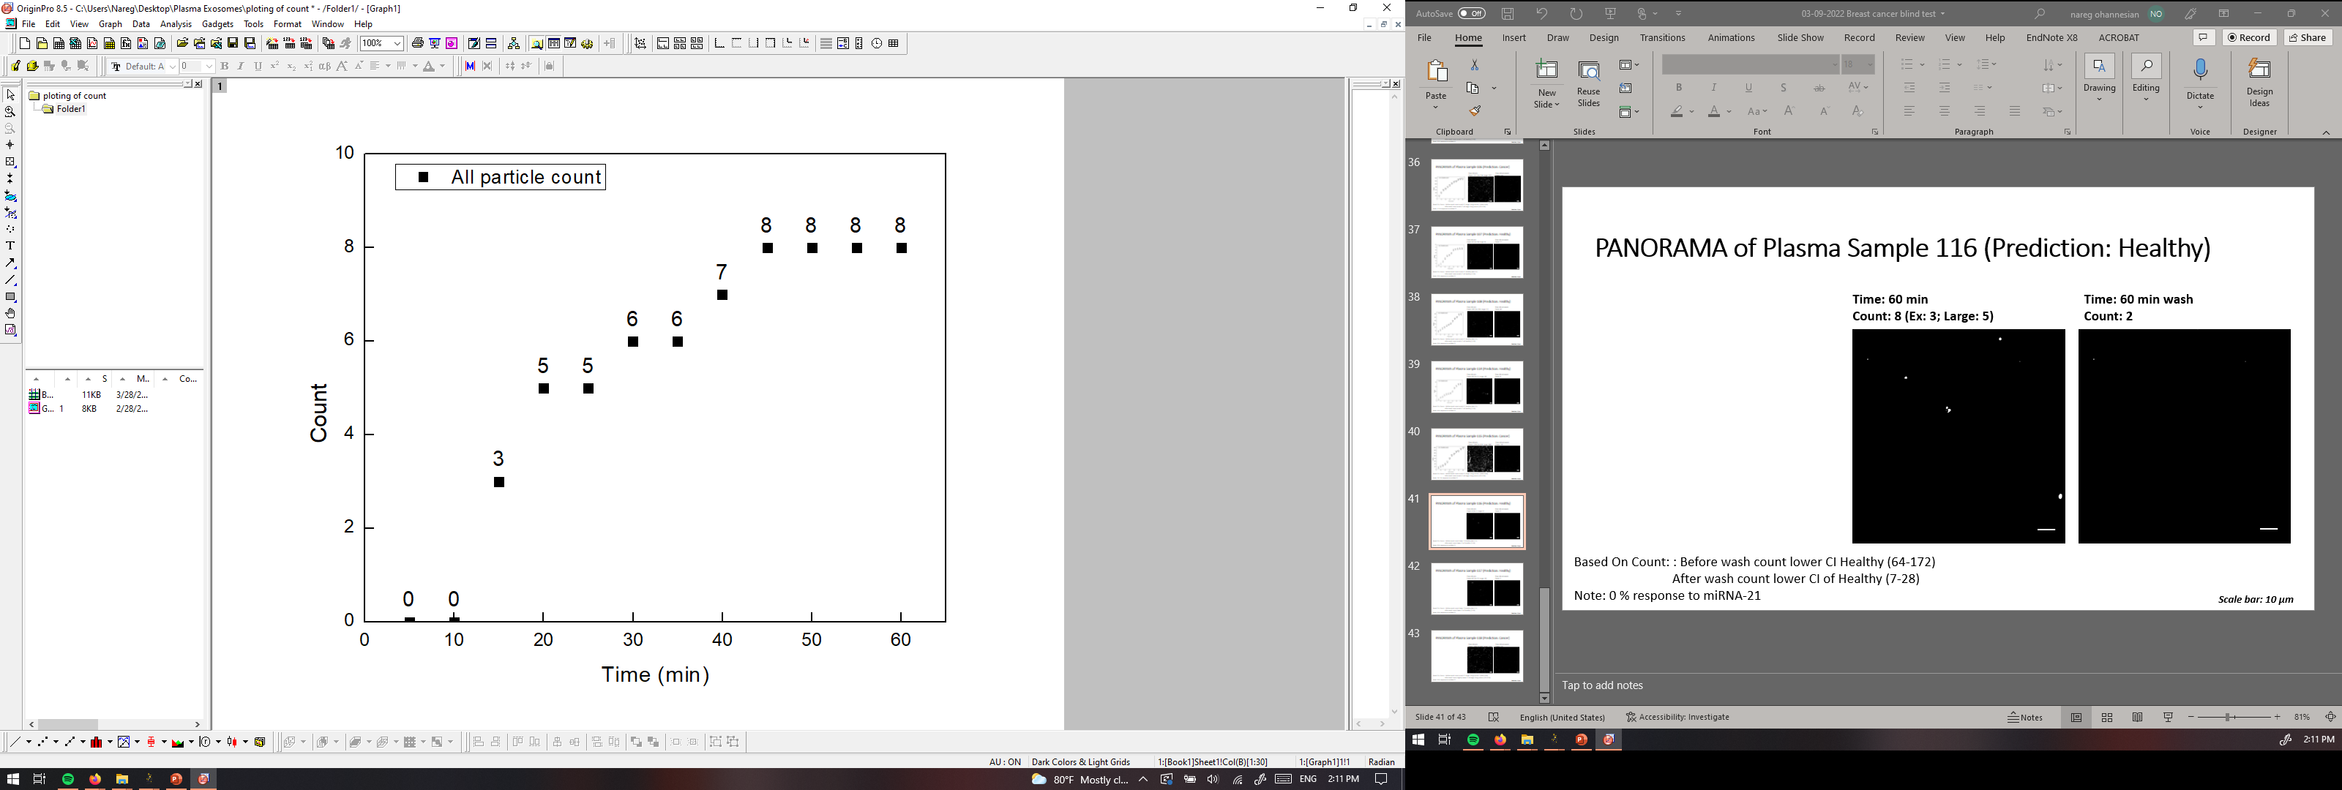
PANORAMA of Plasma Sample 116 (Prediction: Healthy)
Time: 60 min
Count: 8 (Ex: 3; Large: 5)
Time: 60 min wash
Count: 2
Based On Count: : Before wash count lower CI Healthy (64-172)
After wash count lower CI of Healthy (7-28)
Note: 0 % response to miRNA-21
Scale bar: 10 µm

Slide 18


PANORAMA of Plasma Sample 117 (Prediction: Healthy)
Time: 60 min
Count: 47 (Ex: 37; Large: 10)
Time: 60 min wash
Count: 5
Based On Count: : Before wash count lower CI Healthy (64-172)
After wash count lower CI of Healthy (7-28)
Note: 0 % response to miRNA-21
Scale bar: 10 µm

Slide 19


PANORAMA of Plasma Sample 118 (Prediction: Cancer)
Time: 60 min
Count: 1036 (Ex: 863; Large: 173)
Time: 60 min wash
Count: 131
Based On Count: : Before wash count match CI stage I lung cancer 1 (950-1558)
After wash count slightly lower CI of stage I lung cancer (151-370)
Note: 0 % response to miRNA-21
Scale bar: 10 µm

Slide 20
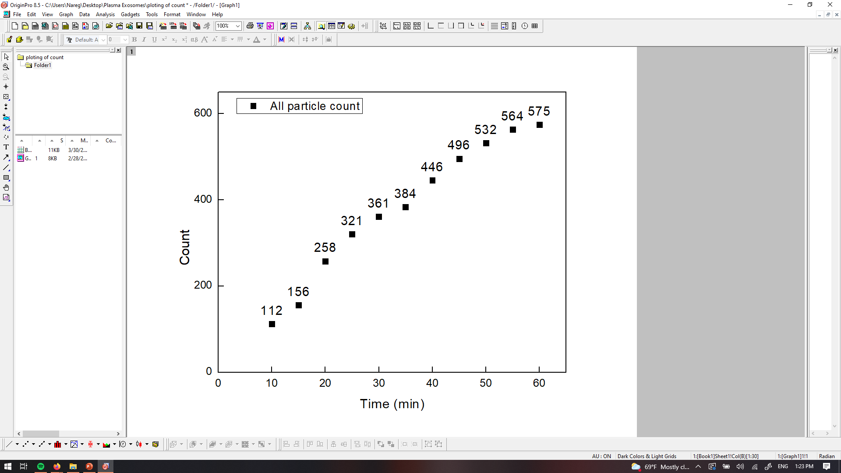
PANORAMA of Plasma Sample 119 (Prediction: Cancer)
Time: 60 min
Count: 575 (Ex: 418; Large: 157)
Time: 60 min wash
Count: 189
Based On Count: : Before wash count match CI stage I lung cancer 1 (950-1558)
After wash count slightly lower CI of stage I lung cancer (151-370)
Note: 3.1 % response to miRNA-21
Scale bar: 10 µm

Slide 21
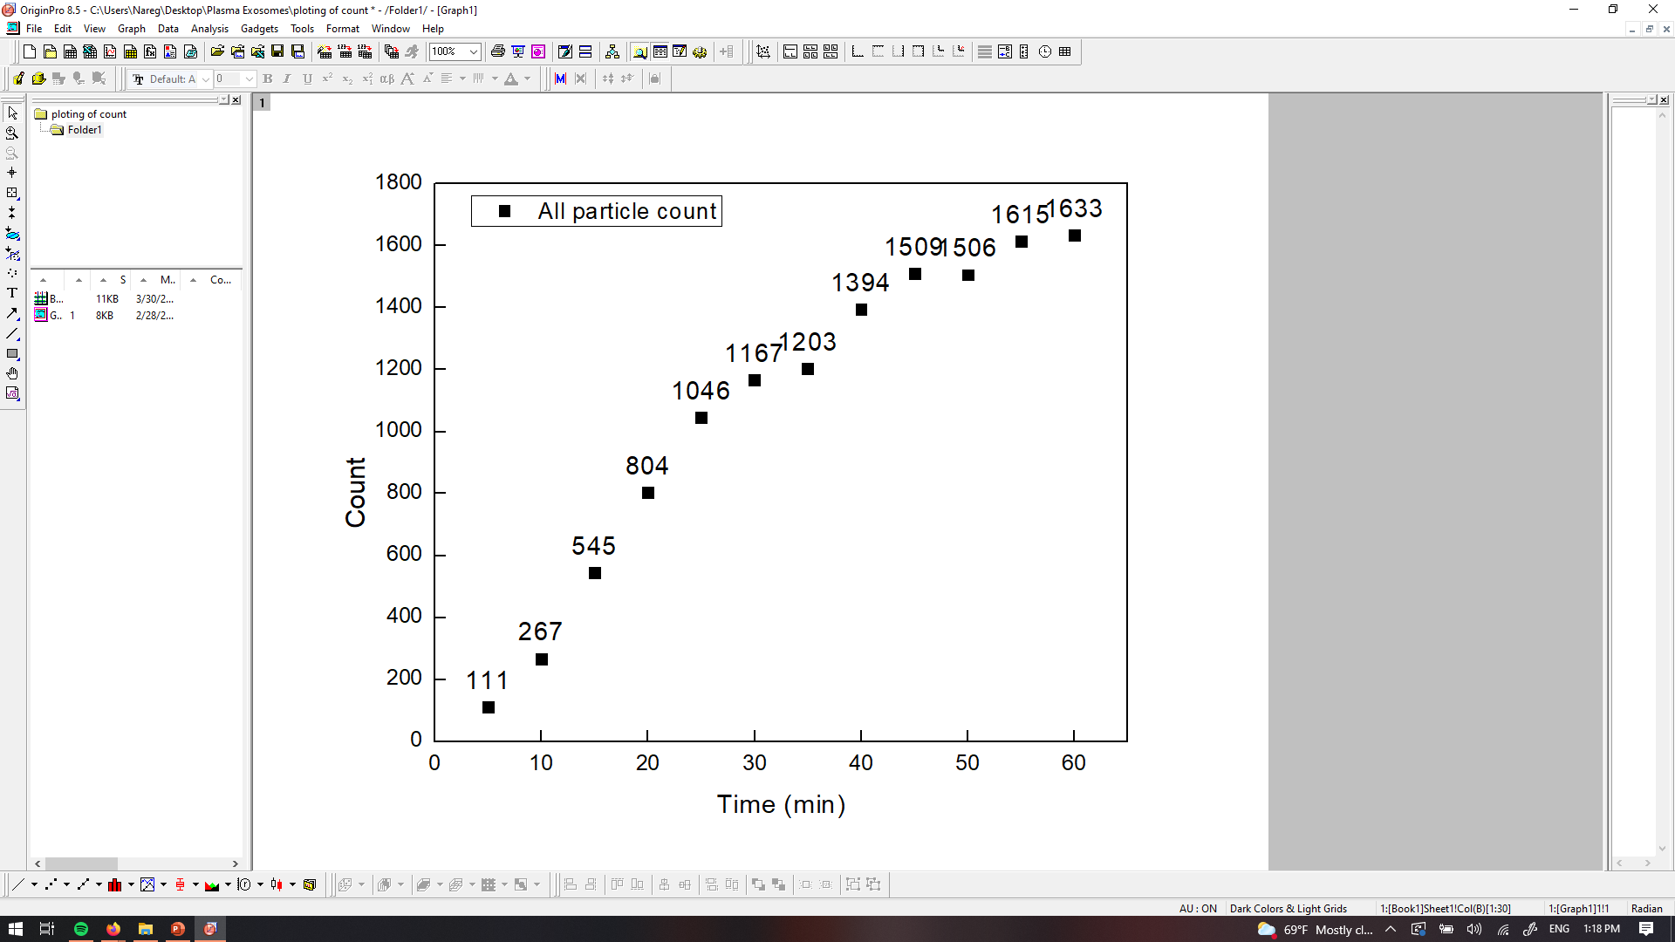
PANORAMA of Plasma Sample 120 (Prediction: Cancer)
Time: 60 min
Count: 1633 (Ex: 1281; Large: 352)
Time: 60 min wash
Count: 274
Based On Count: : Before wash count match CI stage I lung cancer 1 (950-1558)
After wash count slightly lower CI of stage I lung cancer (151-370)
Note: 19 % response to miRNA-21
Scale bar: 10 µm

Slide 22
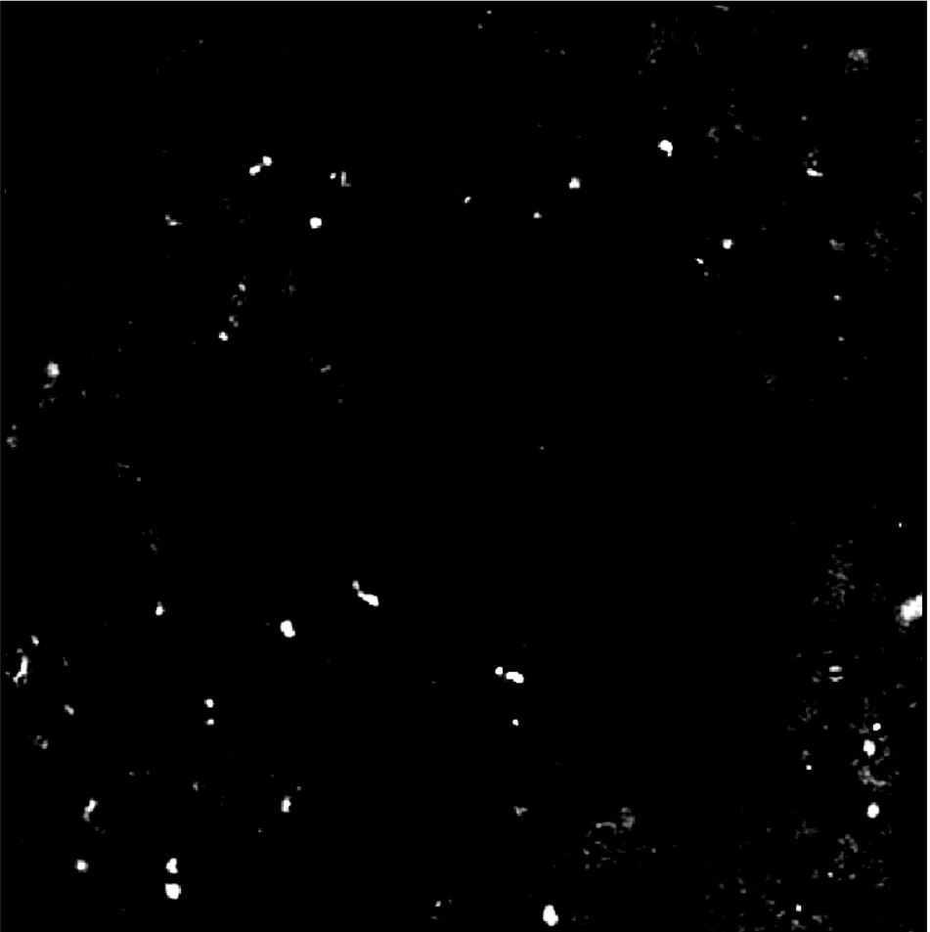
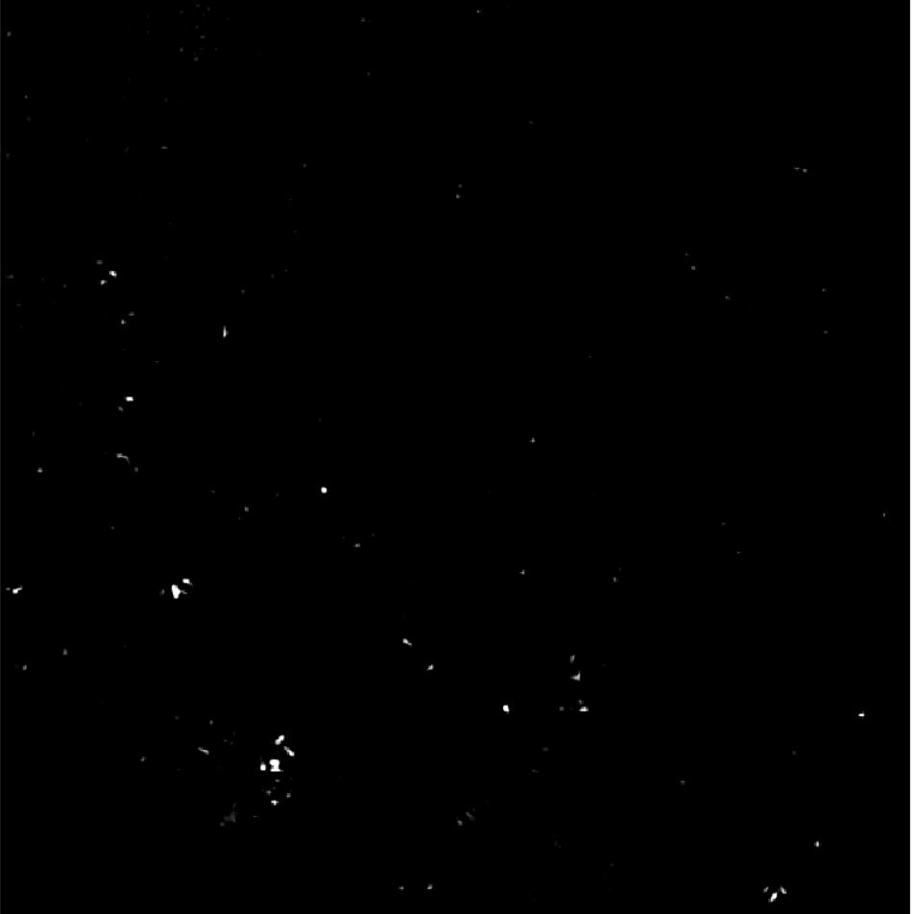
PANORAMA of Plasma Sample 121 (Prediction: Cancer)
Time: 60 min
Count: 154 (Ex: 125; Large: 29)
Time: 60 min wash
Count: 98
Based On Count: Before wash count lower than CI of stage 1 (950-1558)
After wash lower than CI stage 1 (151-370) and
higher than Healthy (5-70)
Note: 0% response to miRNA-21
Look cancerous
Scale Bar: 10 µm

Slide 23
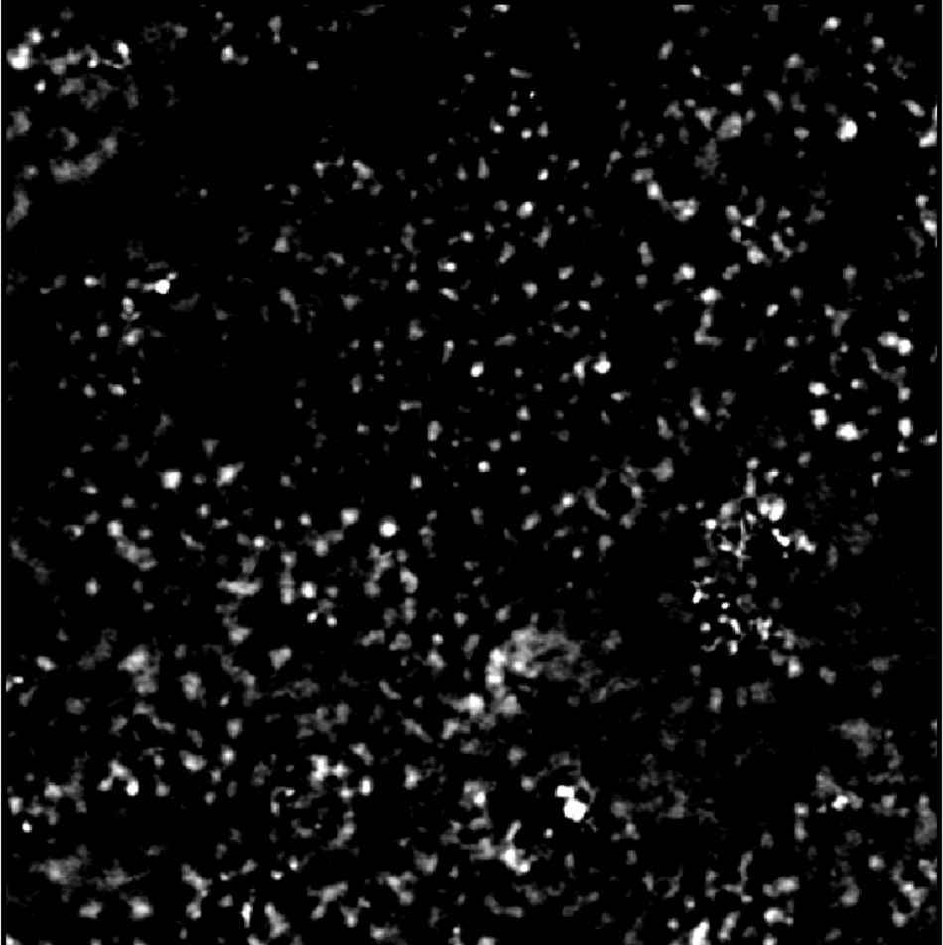
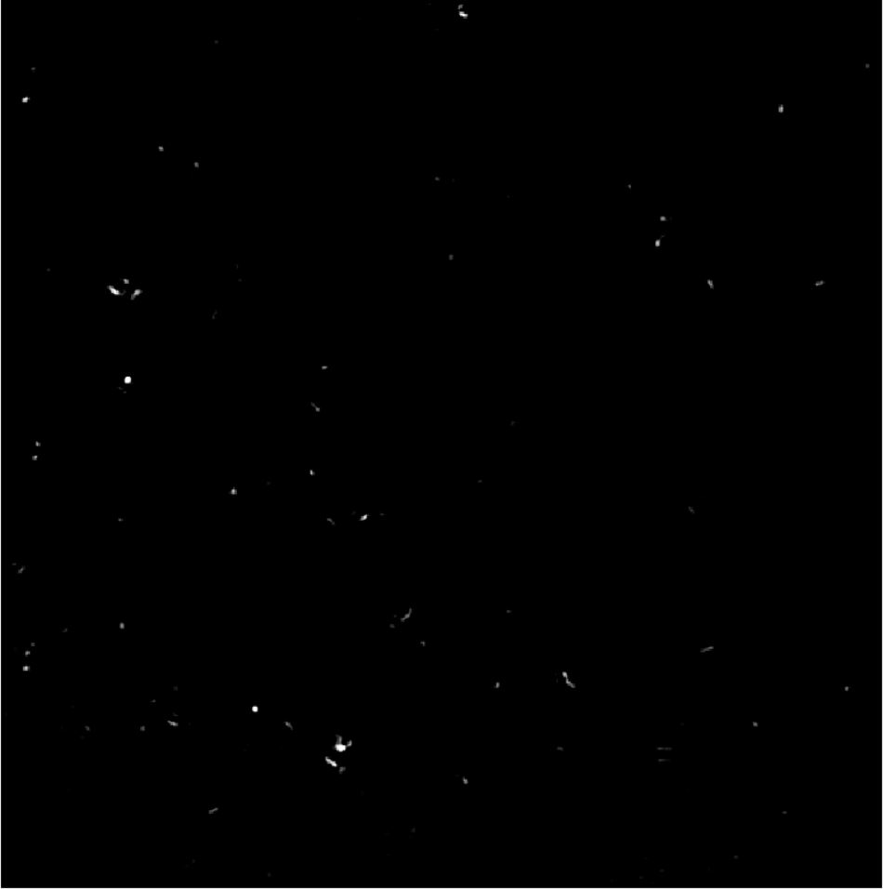
PANORAMA of Plasma Sample 122 (Prediction: Healthy)
Time: 60 min
Count: 451 (Ex: 298; Large: 153)
Time: 60 min wash
Count: 53
Based On Count: Before wash count higher than CI Healthy (64-172)
After wash count higher than 99% CI Healthy (5-28) ) but lower than 70
Note: 0 % response to miRNA-21
Look healthy
Scale Bar: 10 µm

Slide 24

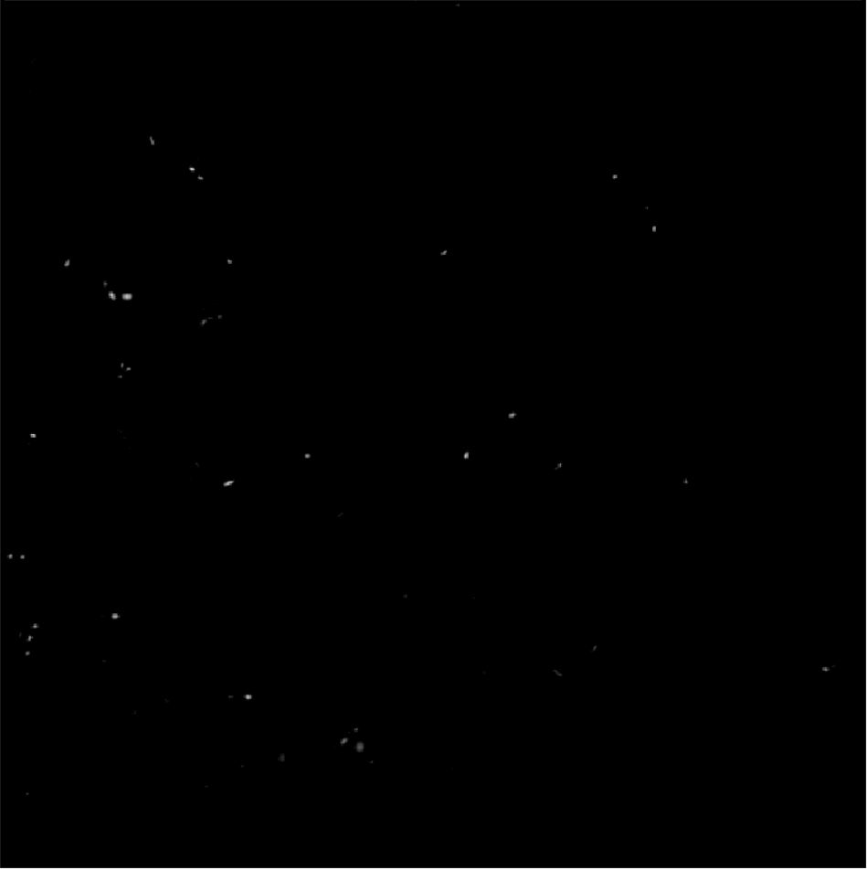
PANORAMA of Plasma Sample 123 (Prediction: Healthy)
Time: 60 min
Count: 114 (Ex: 91; Large: 23)
Time: 60 min wash
Count: 38
Based On Count: Before wash count matches CI Healthy (64-172)
After wash count higher than 99% CI Healthy (5-28) ) but lower than 70
Note: 0 % response to miRNA-21
Look healthy
Scale Bar: 10 µm

Slide 25
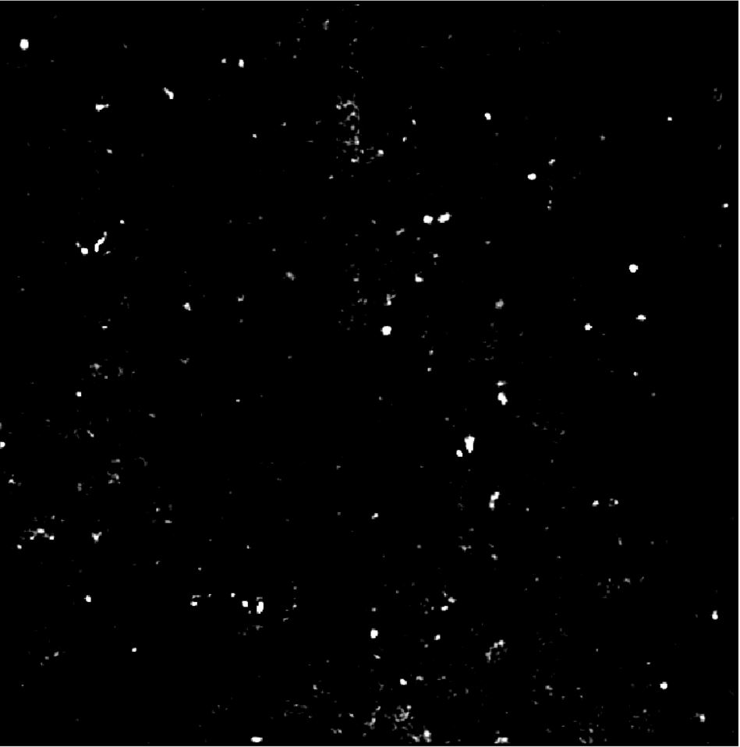

PANORAMA of Plasma Sample 124 (Prediction: Cancer)
Time: 60 min
Count: 291 (Ex: 243; Large: 48)
Time: 60 min wash
Count: 97
Based On Count: Before wash count lower than CI of stage 1 (950-1558)
After wash lower than CI stage 1 (151-370) and
higher than Healthy (5-70)
Note: 0% response to miRNA-21
Look cancerous
Scale Bar: 10 µm

Slide 26
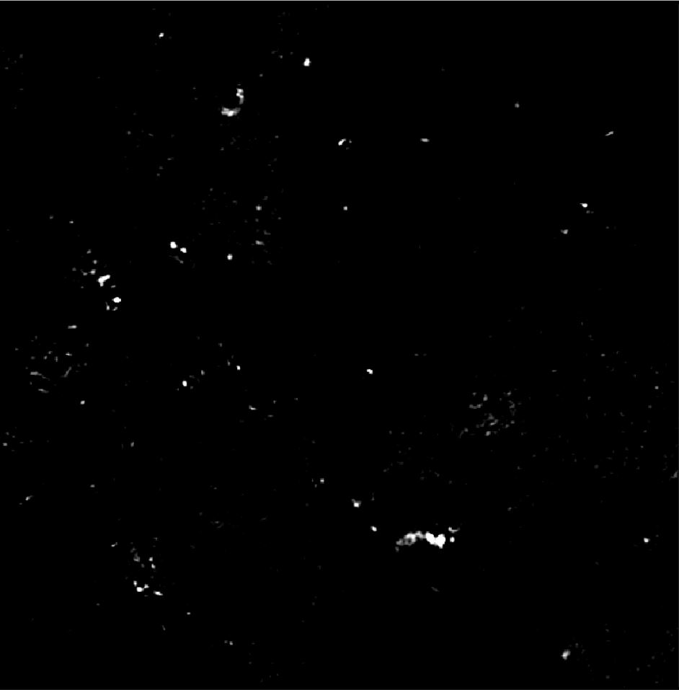
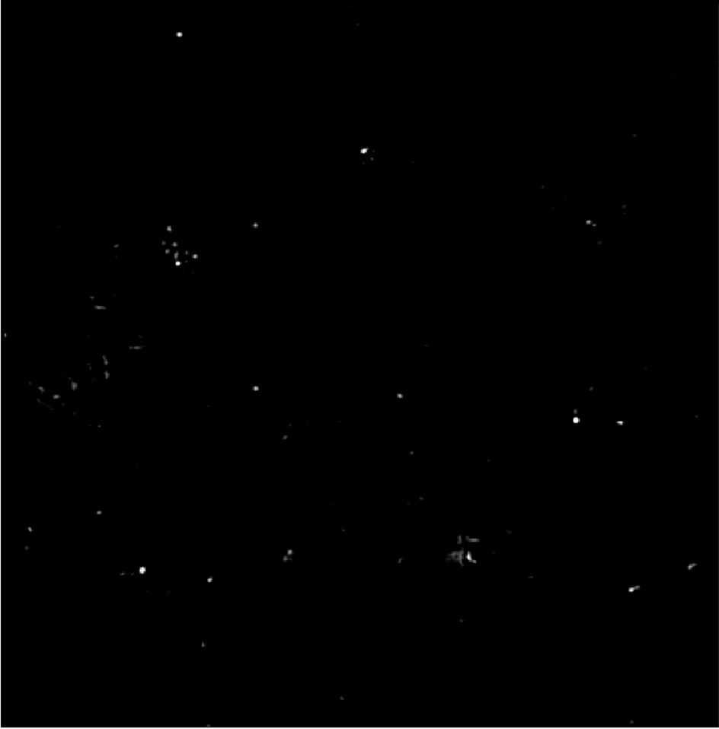
Image of Detected Particles via PANORAMA (125)
Time: 60 min
Count: 169 (Ex: 149; Large: 20)
Time: 60 min wash
Count: 56
Based On Count: Before wash count is higher than CI Healthy (64-172)
After wash count higher than 99% CI Healthy (5-28) but lower than 70
Note: 0 % response to miRNA-21
Look healthy
Scale Bar: 10 µm

Slide 27
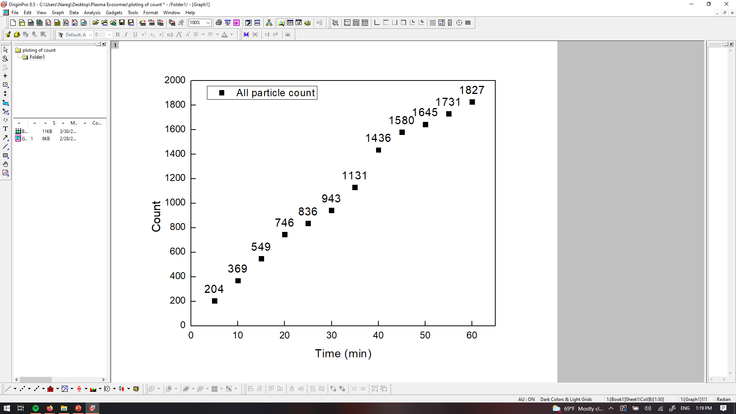
PANORAMA of Plasma Sample 126 (Prediction: Cancer)
Time: 60 min
Count: 1827 (Ex: 1677; Large: 150)
Time: 60 min wash
Count: 398
Based On Count: : Before wash count match CI stage I lung cancer 1 (950-1558)
After wash count slightly lower CI of stage I lung cancer (151-370)
Note: 1v6 % response to miRNA-21
Scale bar: 10 µm

Slide 28
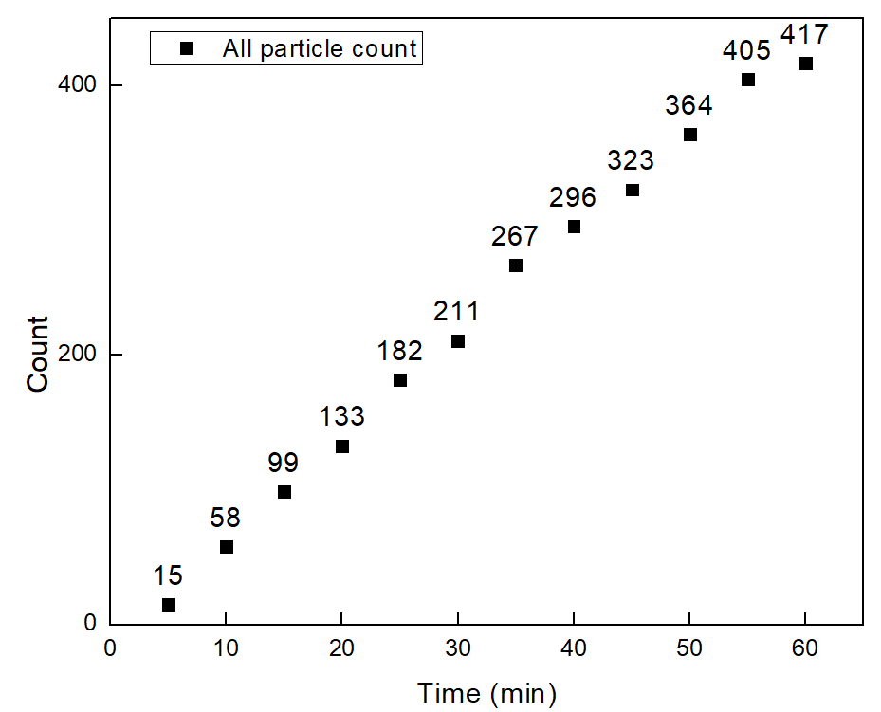


PANORAMA of Plasma Sample 127 (Prediction: Cancer)
Time: 60 min
Count: 417 (Ex: 358; Large: 59)
Time: 60 min wash
Count: 108
Note: 0 % response to miRNA-21
Scale bar: 10 µm

Slide 29
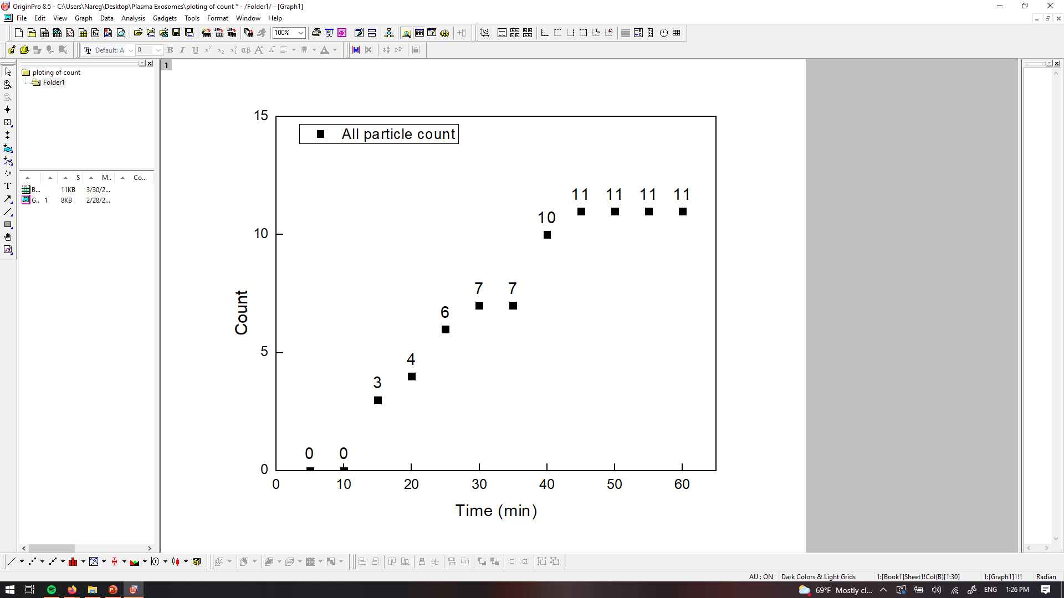
PANORAMA of Plasma Sample 128 (Prediction: Healthy)
Time: 60 min
Count: 11 (Ex: 9; Large: 2)
Time: 60 min wash
Count: 3
Based On Count: : Before wash count lower CI Healthy (64-172)
After wash count lower CI of Healthy (7-28)
Note: 0 % response to miRNA-21
Scale bar: 10 µm

Slide 30
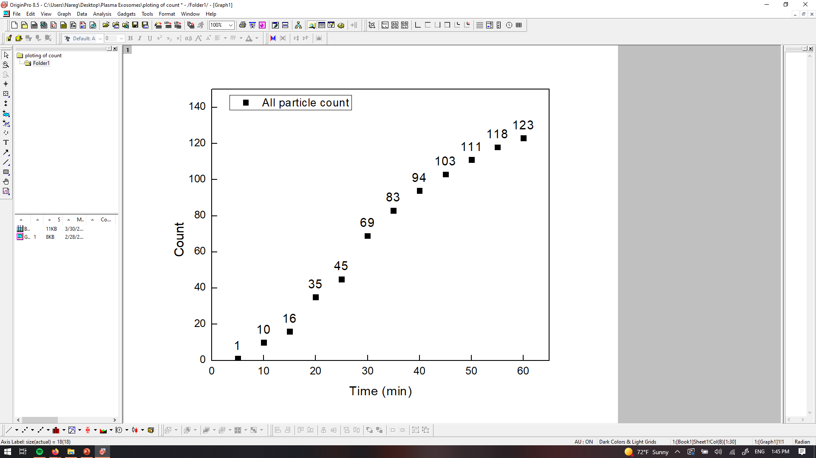
PANORAMA of Plasma Sample 129 (Prediction: Healthy)
Time: 60 min
Count: 123 (Ex: 67; Large: 36)
Time: 60 min wash
Count: 57
Based On Count: : Before wash count matches CI Healthy (64-172)
After wash count higher CI of Healthy (7-28)
Note: 0 % response to miRNA-21
Scale bar: 10 µm

Slide 31
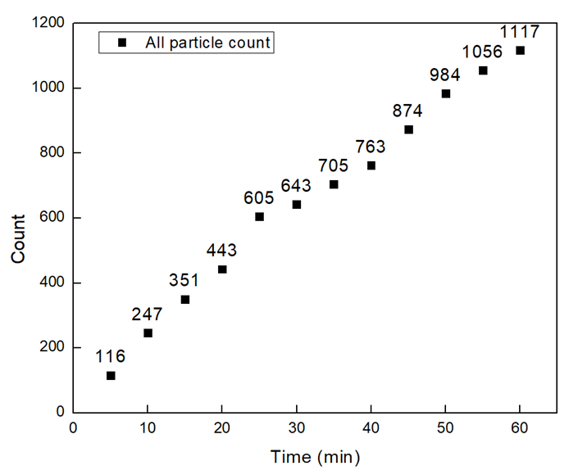


PANORAMA of Plasma Sample 130 (Prediction: Cancer)
Time: 60 min
Count: 1117 (Ex: 982; Large: 135)
Time: 60 min wash
Count: 432
Based On Count: : Before wash count match CI stage I lung cancer 1 (950-1558)
After wash count slightly lower CI of stage I lung cancer (151-370)
Note: 0 % response to miRNA-21
Scale bar: 10 µm

Slide 32
Patient | Total Particles | Large Particles | Exosomes like particles | Retained Exosomes | mir-21% | Prediction | Actual State | Sample
52 | 152 | 35 | 117 | 11 | 0 | Healthy | Healthy | HCR 129
53 | 178 | 31 | 147 | 27 | 0 | Healthy | Healthy | HCR 130
54 | 216 | 48 | 168 | 45 | 0 | Healthy | Healthy | HCR 134
55 | 236 | 77 | 159 | 49 | 0 | Healthy | Healthy | HCR 132
56 | 194 | 32 | 162 | 59 | 0 | Healthy | Healthy | HCR 133
57 | 325 | 84 | 241 | 111 | 11% | Cancer | Cancer | 222-1
58 | 1486 | 46 | 1440 | 68 | 0 | Healthy | Healthy | HCR 113
59 | 675 | 48 | 627 | 206 | 27% | Cancer | Cancer | 222-2
60 | 355 | 72 | 283 | 211 | 27% | Cancer | Cancer | 222-3
61 | 713 | 193 | 283 | 290 | 0% | Cancer | Cancer | 222-4
62 | 91 | 16 | 75 | 5 | 0% | Healthy | Healthy | HCR 137
63 | 432 | 84 | 348 | 292 | 0% | Cancer | Cancer | 222-5
64 | 148 | 37 | 111 | 18 | 0% | Healthy | Healthy | HCR 136
65 | 190 | 48 | 142 | 10 | 0% | Healthy | Healthy | HCR 138
66 | 606 | 204 | 402 | 224 | 10% | Cancer | Cancer | 222-6
67 | 1088 | 170 | 918 | 196 | 19% | Cancer | Cancer | 222-7
68 | 1420 | 341 | 1079 | 476 | 48% | Cancer | Cancer | 222-8
69 | 669 | 475 | 194 | 66 | 0% | Healthy | Healthy | HCR 131
70 | 1314 | 180 | 1134 | 212 | 22% | Cancer | Cancer | 222-9
71 | 199 | 31 | 168 | 95 | 0 | Cancer | Cancer | 222-20
72 | 138 | 33 | 105 | 9 | 0 | Healthy | Healthy | HCR 149
73 | 2026 | 928 | 1098 | 277 | 0% | Cancer | Cancer | 222-10
74 | 261 | 90 | 171 | 8 | 0% | Healthy | Healthy | HCR 148
75 | 468 | 345 | 123 | 40 | 0% | Healthy | Healthy | HCR 147
76 | 103 | 60 | 43 | 34 | 0% | Healthy | Healthy | HCR 145
77 | 217 | 57 | 160 | 25 | 0% | Cancer | Cancer | 222-11
78 | 144 | 50 | 94 | 22 | 0% | Healthy | Healthy | HCR 143
79 | 1621 | 457 | 1164 | 333 | 19% | Cancer | Cancer | 222-12
80 | 1778 | 795 | 983 | 340 | 17% | Cancer | Cancer | 222-13
81 | 935 | 300 | 632 | 123 | 0% | Cancer | Cancer | 222-14
82 | 2001 | 796 | 1205 | 683 | 0% | Cancer | Cancer | 222-15
83 | 222 | 101 | 121 | 3 | 0% | Healthy | Healthy | HCR 142
84 | 617 | 113 | 504 | 123 | 0% | Cancer | Cancer | 222-16
85 | 445 | 100 | 345 | 34 | 0% | Healthy | Healthy | HCR 139
86 | 352 | 125 | 227 | 105 | 6% | Cancer | Cancer | 222-17
87 | 297 | 84 | 213 | 55 | 0 | Healthy | Healthy | HCR 103
88 | 371 | 44 | 327 | 28 | 0 | Healthy | Healthy | HCR 98
89 | 234 | 70 | 164 | 43 | 0 | Healthy | Healthy | HCR 96
90 | 481 | 157 | 324 | 108 | 7.10% | Cancer | Cancer | 222-19
91 | 1033 | 219 | 814 | 81 | 0 | Healthy | Healthy | HCR 93
92 | 1170 | 300 | 870 | 69 | 0 | Healthy | Healthy | HCR 107
93 | 840 | 148 | 692 | 456 | 0 | Cancer | Cancer | 222-18
94 | 617 | 158 | 459 | 51 | 0 | Healthy | Healthy | HCR 94
95 | 91 | 11 | 80 | 8 | 0 | Healthy | Healthy | HCR 108
96 | 210 | 14 | 196 | 35 | 0 | Healthy | Healthy | HCR 151
97 | 231 | 27 | 204 | 17 | 0 | Healthy | Healthy | HCR 86
98 | 196 | 39 | 157 | 30 | 0 | Healthy | Healthy | HCR 105
99 | 84 | 24 | 60 | 40 | 0 | Healthy | Healthy | HCR 106

Slide 33
Patient | Total Particles | Large Particles | Exosomes like particles | Retained Exosomes | mir-21% | Prediction
100 | 227 | 49 | 178 | 32 | 0 | Healthy
101 | 265 | 83 | 182 | 35 | 0 | Healthy
102 | 901 | 297 | 535 | 190 | 6 | Cancer
103 | 819 | 101 | 718 | 25 | 0 | Healthy
104 | 901 | 297 | 535 | 190 | 0 | Cancer
105 | 63 | 9 | 54 | 11 | 0 | Healthy
106 | 1311 | 577 | 734 | 153 | 12 | Cancer
107 | 63 | 9 | 54 | 11 | 0 | Healthy
108 | 287 | 31 | 256 | 43 | 0 | Healthy
109 | 208 | 28 | 180 | 109 | 0 | Cancer
110 | 320 | 62 | 258 | 137 | 0 | Cancer
111 | 158 | 35 | 123 | 39 | 0 | Healthy
112 | 244 | 37 | 207 | 30 | 0 | Healthy
113 | 236 | 60 | 176 | 123 | 0 | Cancer
114 | 69 | 18 | 51 | 8 | 0 | Healthy
115 | 1538 | 908 | 630 | 185 | 16.7 | Cancer
116 | 8 | 5 | 3 | 2 | 0 | Healthy
117 | 47 | 10 | 37 | 5 | 0 | Healthy
118 | 1036 | 173 | 863 | 131 | 0 | Cancer
119 | 575 | 157 | 418 | 189 | 3.1 | Cancer
120 | 1633 | 352 | 1281 | 274 | 19 | Cancer
121 | 154 | 29 | 125 | 98 | 0 | Cancer
122 | 451 | 153 | 298 | 53 | 0 | Healthy
123 | 114 | 23 | 91 | 38 | 0 | Healthy
124 | 291 | 48 | 243 | 97 | 0 | Cancer
125 | 169 | 20 | 149 | 56 | 0 | Healthy
126 | 1827 | 150 | 1677 | 398 | 16 | Cancer
127 | 417 | 59 | 358 | 108 | 0 | Cancer
128 | 11 | 2 | 9 | 3 | 0 | Healthy
129 | 123 | 36 | 67 | 57 | 0 | Healthy
130 | 1117 | 135 | 982 | 432 | 0 | Cancer

Slide 34
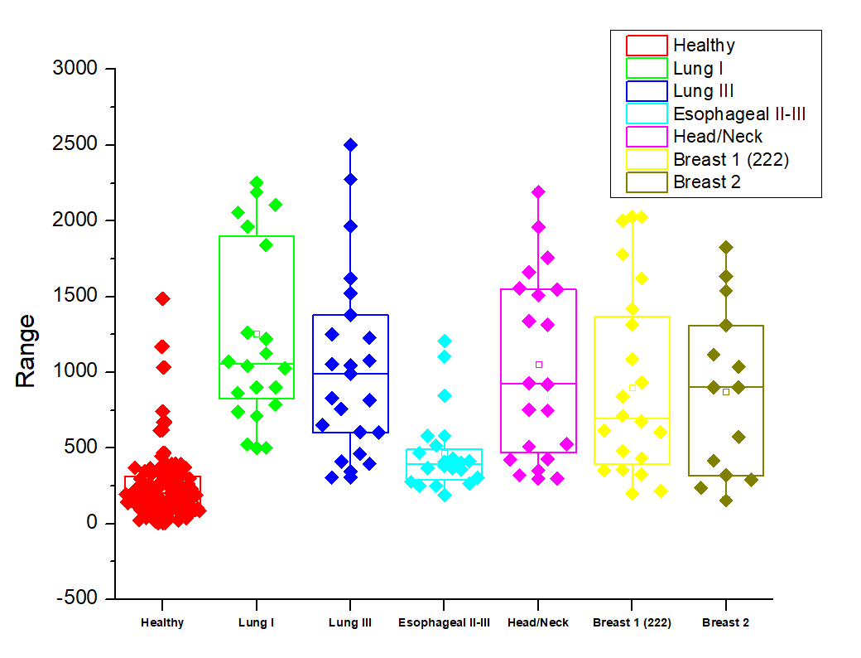
Summary of collected data
All Particles
Number of samples
Healthy: 136 (around 30 more)
Lung I: 20
Lung II: 23
Esophageal II-II: 20
Head and Neck: 20
Breast (222): 20
Breast 2: 14 so far

Slide 35
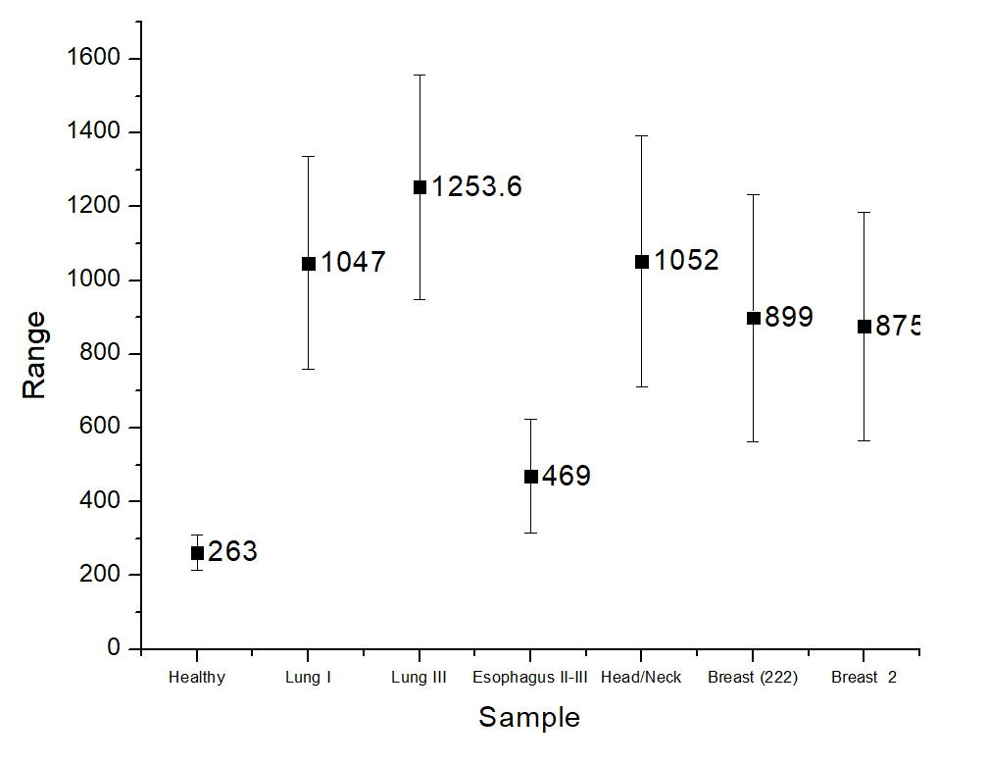
99% Confidence Interval: All detected Particles

Slide 36
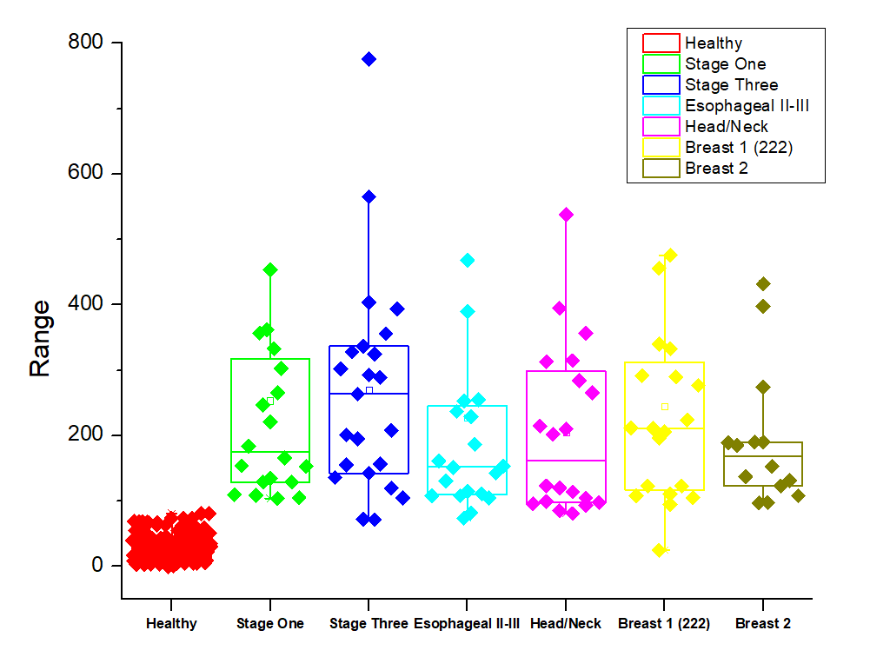
Summary of collected data
Retained Exosomes
Number of samples
Healthy: 136 (around 30 more)
Lung I: 20
Lung II: 23
Esophageal II-II: 20
Head and Neck: 20
Breast (222): 20
Breast 2: 14 so far

Slide 37
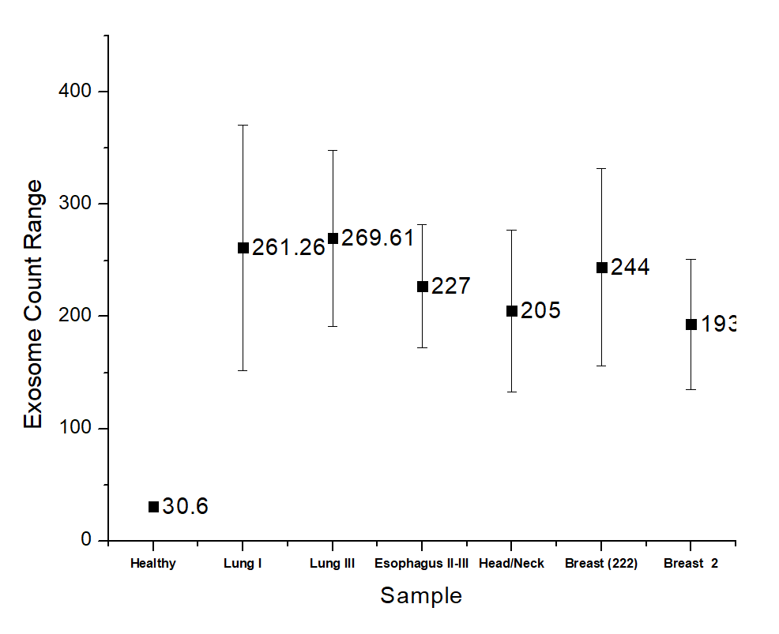
99% Confidence Interval: Retained Exosomes

Slide 38
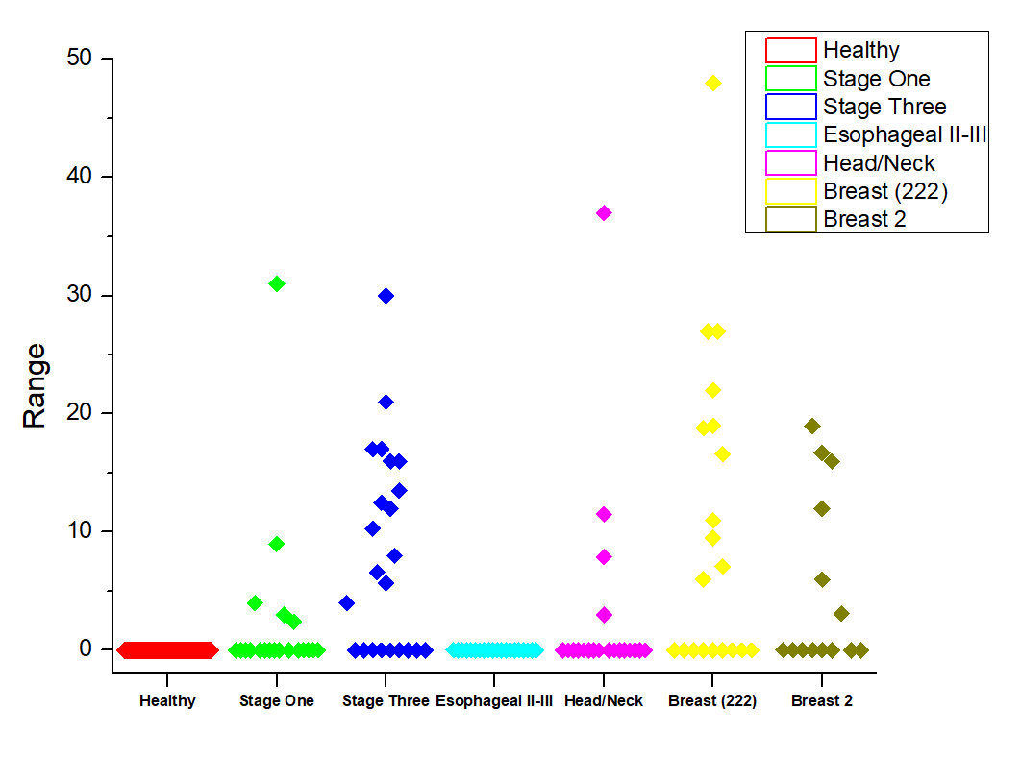
Summary of collected data
MIR-21 Expression within retained exosomes
Number of samples
Healthy: 136 (around 30 more)
Lung I: 20
Lung II: 23
Esophageal II-II: 20
Head and Neck: 20
Breast (222): 20
Breast 2: 14 so far

